Slide 1
Software Construction Laboratory CS35L – Lab 1
Course Webpage: https://web.cs.ucla.edu/classes/fall18/cs35L/index.html
TA: Zhiyi Zhang
Email: zhiyi@cs.ucla.edu
Webpage: https://zhiyi-zhang.com

Slide 2
Session 6-1
Multithread

Slide 3
Multithread

Slide 4
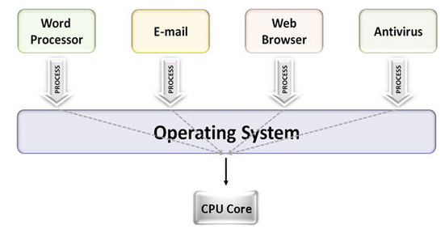
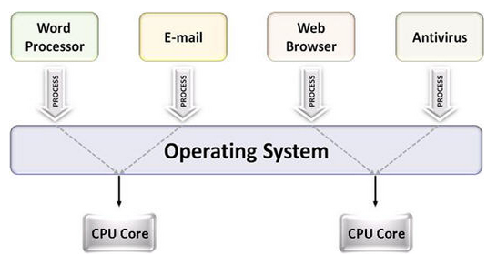
Multiprocessing
The use of multiple CPUs/cores to run multiple tasks simultaneously
Uni-processing system
Multiprocessing system

Slide 5
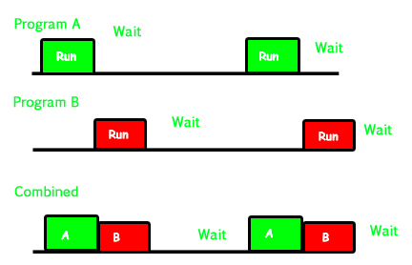
Multiprocessing
In a uni-processor system, only one process executes at a time.
Multiprocessing is the use of two or more CPUs (processors) within a single Computer system.
Multiprocessing refers to the hardware (i.e., the CPU units) rather than the software (i.e., running processes).
Uni-processing system

Slide 6
Parallelism
Executing several computations simultaneously to gain performance
Different forms of parallelism
Multitasking: The ability to run several processes simultaneously.
Predominately executed alternately on uni-processing system
Potentially executed simultaneously on a multiprocessing system
Multithreading: The ability to run several functions of a single program simultaneously.
Predominately executed simultaneously on a multiprocessing system
Potentially executed alternately on uni-processing system

Slide 7
Examples of Multitasking
Your operating system allows you to run multiple process at the same time
ps -ef or top to check the running processes
tr -cs 'A-Za-z' '[\n*]' | sort -u | comm -23 – words
Process 1 (tr)
Process 2 (sort)
Process 3 (comm)
Each process has its own address space
How do these processes communicate? Pipes (System Calls)

Slide 8
Thread
A flow of instructions, path of execution within a process. Thread is the smallest unit of processing scheduled by OS.
Each process consists of at least one thread
Multiple threads can be run on:
uniprocessor (time-sharing)
Processor switches between different threads
Parallelism is an illusion
multiprocessor
Multiple processors or cores run the threads at the same time
True parallelism

Slide 9
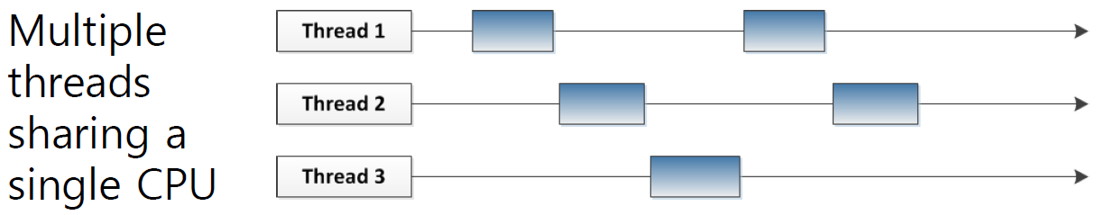
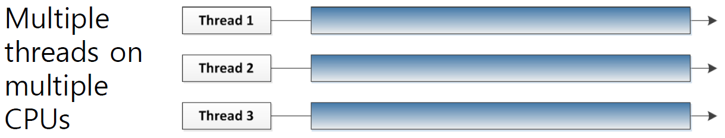
Multithreading with single/multiple CPUs

Slide 10
Examples of Multithreading
When you open a new webpage in your browser
Multi-thread HTML references downloading
When you click a button in GUI (thread), some background thread do calculation and reflects the result back to GUI
Google’s web server can handle many requests at the same time

Slide 11
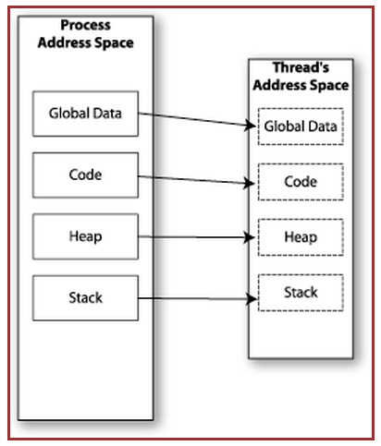

Memory Layout: Single-Threaded Program

Slide 12
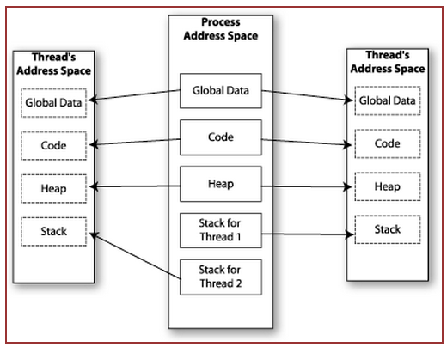

Memory Layout: Multithreaded Program

Slide 13
Multithreading
Threads share all of the process's memory except for their stacks. Therefore, data sharing requires no extra work (no system calls, pipes, etc.)
Shared memory makes multithreaded programming
Powerful: can easily access data and share it among threads
More efficient: No need for system calls when sharing data and thread creation and destruction are less expensive than process creation and destruction
Non-trivial: Have to prevent several threads from accessing and changing the same shared data at the same time (synchronization)

Slide 14
Race Condition
Live Demonstration

